Slide 1

VISHWAKARMA INSTITUTE OF TECHNOLOGY, PUNE
DEPARTMENT OF COMPUTER SCIENCE AND ENGINEERING (ARTIFICIAL INTELLIGENCE)
A.Y 2025-26 SEM (II)
Title: BuildSim – Virtual Construction Planning and Simulation Platform
SY - CSAI-E
GROUP NO: 06
GUIDE NAME: DR. NILESH KORADE

Slide 2
Group Members
Name PRN Roll No.
Vedanti Raut 12413458 38
Saachi Laturiya 12414728 42
Utkarsh Salunkhe 12412161 51
Vaidik Samarth 12410371 52

Slide 3
Contents
1) Introduction
2) Motivation
3) Problem Statement
4) Objectives
5) Literature Review
6) System Design and Architecture
7) Technology Stack
8) Tech Stack
9) What’s New and Unique
10) Key Feature – Role Based Dashboard
11) Challenges and Future Scope
12) Conclusion
13) References

Slide 4
Introduction
Modern construction projects require coordination among planners, architects, civil engineers, and project managers. Traditional workflows often rely on static drawings and disconnected tools, making project evaluation difficult before execution.
BuildSim is a web-based construction planning and simulation platform that enables stakeholders to visualize, analyze, and manage projects through role-based dashboards.
The system integrates:
• 3D building visualization • Construction progress simulation • Structural analysis • Resource and budget planning • Risk assessment and decision support
By combining visualization and simulation, BuildSim helps stakeholders make informed decisions, improve collaboration, and reduce project uncertainties before construction begins.

Slide 5
Motivation
The construction industry involves multiple stakeholders working across planning, design, structural analysis, and project management. These activities are often performed using separate tools, making collaboration difficult and reducing visibility into the overall project lifecycle. As a result, project teams may face communication gaps, planning inefficiencies, budget overruns, and delays.
The motivation behind BuildSim is to create a unified platform where different stakeholders can visualize, analyze, and simulate construction projects before execution. By integrating project planning, design review, structural assessment, and management insights into a single environment, the platform aims to support better decision-making and improve coordination among project participants. This simulation-driven approach helps identify potential issues early and enables stakeholders to evaluate alternatives before actual construction begins.

Slide 6
Problem Statement
Construction planning often relies on static blueprints and manual scheduling methods that do not provide insights into how different project components interact during execution.
As a result, projects frequently experience:
Structural design conflicts
Inaccurate cost estimation
Inefficient resource allocation
Unexpected delays
There is therefore a need for a digital simulation platform that integrates building visualization, construction sequencing, cost estimation, and predictive analytics to improve project planning and reduce construction risks.

Slide 7
Objectives
The primary objectives of BuildSim are:
Develop a role-based construction simulation platform.
Provide interactive 3D building visualization.
Simulate construction progress and workflows.
Support architectural design evaluation.
Enable structural analysis and feasibility assessment.
Facilitate project monitoring and resource management.
Improve collaboration among construction stakeholders.
Promote simulation-driven decision making.

Slide 8
Literature Review
Title | Authors | Year | Findings | Research Gap
AI-Based Construction Project Delay Prediction | Egwim et al. | 2021 | Machine learning models can predict construction delays using project parameters such as labor availability, material delivery, and project complexity. | Focuses only on delay prediction models and lacks integration with interactive construction planning or visualization platforms.
BIM-Based Construction Simulation for Project Monitoring | Kropp et al. | 2019 | BIM-based systems enable digital monitoring of construction progress and help identify schedule deviations. | Requires real-time site data and complex infrastructure, making it difficult to use for early-stage planning or educational environments.

Slide 9
Literature Review
Title | Authors | Year | Findings | Research Gap
Enhanced Clash Detection in Building Information Modeling | Shehadeh | 2024 | Automated systems can detect structural clashes between building components, improving coordination between design elements. | Existing systems produce large numbers of clash reports but lack integrated simulation and visualization for better interpretation.
Impact of BIM Applications on Construction Delays and Cost Overruns | Ahmed et al. | 2020 | BIM technology improves coordination among stakeholders and reduces project delays and cost overruns. | Many BIM platforms are complex enterprise tools and are not easily accessible for smaller teams or academic use.

Slide 10
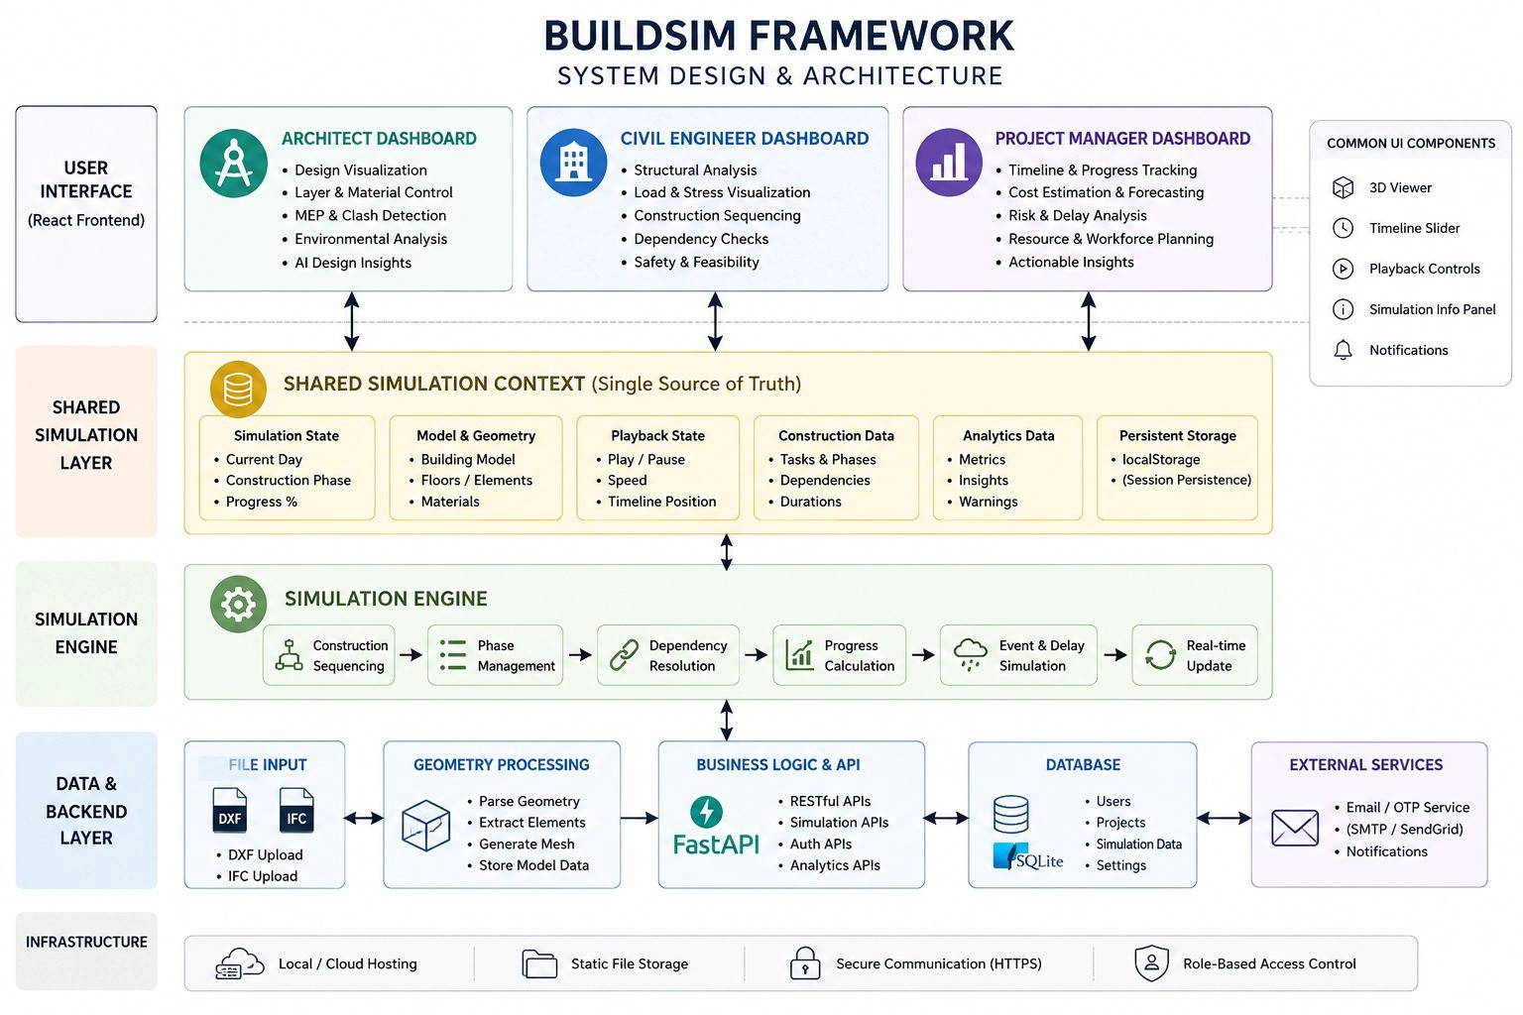

Slide 11
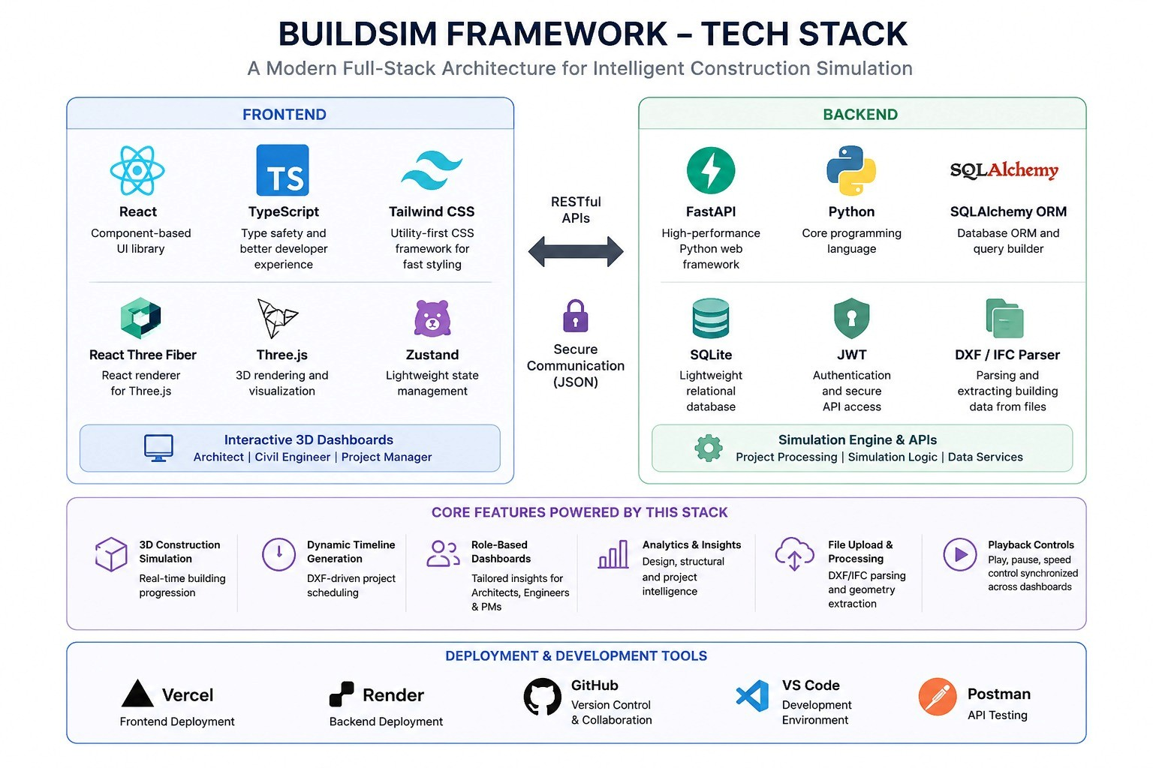

Slide 12
What's New & Unique
Shared Architecture
Same building, same timeline
Same geometry for all roles Centralized simulation engine
Dynamic Insights
Geometry-based (not hardcoded)
Responds to layout complexity
Adapts to simulation state
File Integration
DXF plan upload support
IFC model import
Procedural geometry gen.

Slide 13
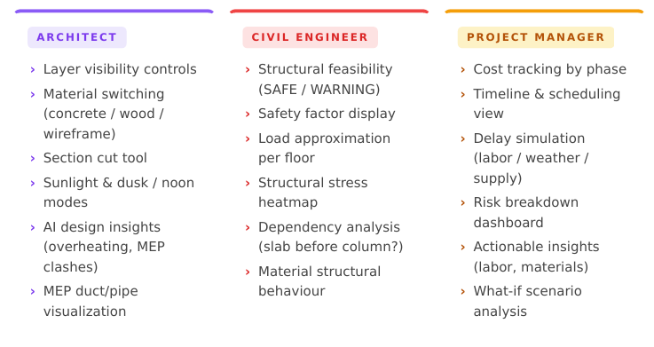
Key Feature – Role Based Dashboard

Slide 14
Challenges and Future Scope
Key Challenges
Shared state sync across all dashboards
Enforcing realistic construction sequencing
DXF → usable procedural geometry pipeline
Clean role separation with no tool overlay
Future Scope
Render (BE) Real BIM integration & digital twin systems
AI-powered scheduling optimisation AR/VR walkthroughs & IoT sensors
Real-time cloud collaboration

Slide 15
Conclusion
BuildSim demonstrates the effectiveness of a role-based construction simulation platform in supporting planning, design evaluation, structural analysis, and project management within a single system. By integrating stakeholder-specific dashboards with interactive visualization and simulation capabilities, the platform enables users to analyze project conditions, assess alternatives, and understand the impact of decisions before implementation. The project successfully shifts the focus from static monitoring to simulation-driven decision support, improving collaboration and planning efficiency. With future enhancements such as advanced BIM integration and more sophisticated simulations, BuildSim has the potential to become a comprehensive tool for modern construction planning and management.

Slide 16
References
O. Egwim, et al., “Machine learning models for predicting construction project delays,” J. Constr. Eng. Manage., vol. 147, no. 3, 2021, pp. 1–12.
J. Kropp, et al., “A framework for automated delay prediction using BIM-based construction simulation,” Proc. Int. Conf. Comput. Civ. Build. Eng., 2019, pp. 210–217.
A. Shehadeh, et al., “Enhanced clash detection in building information modeling using computational techniques,” Automation in Construction, vol. 158, 2024, pp. 105–118.
S. Ahmed, et al., “Impact of building information modeling on construction project delays and cost overruns,” J. Constr. Manage., vol. 136, no. 4, 2020, pp. 331–340.
M. Abanda and L. Byers, “An investigation of the impact of building information modeling on construction project performance,” J. Eng. Des. Technol., vol. 14, no. 4, 2016, pp. 929–950.
X. Wang, et al., “Building information modeling-based 4D simulation for construction planning and scheduling,” Automation in Construction, vol. 85, 2018, pp. 10–23.
S. Chou, et al., “Predicting construction project success using machine learning algorithms,” Expert Systems with Applications, vol. 48, 2016, pp. 124–132.

